Slide 1
MARKETING & BUSINESS REGULATION
Positioning
Positioning Strategies
Building Digital Presence and Leveraging Social Media
Measuring Effectiveness Of Channels
Customer Decision – Making Process
Sales Plans And Targets
Unique Sales Proposition(USP)
Follow-up and Close Sales
Business Regulations Of Starting and Operating a Business
Start-up Ecosystem
Government Schemes

Slide 2
POSITIONING
In Marketing and business strategy, market position refers to the consumer's perception of a brand or product in relation to competing brands or products.
Market positioning refers to the process of establishing the image or identity of a brand or product so that consumers perceive it in a certain way

Slide 3
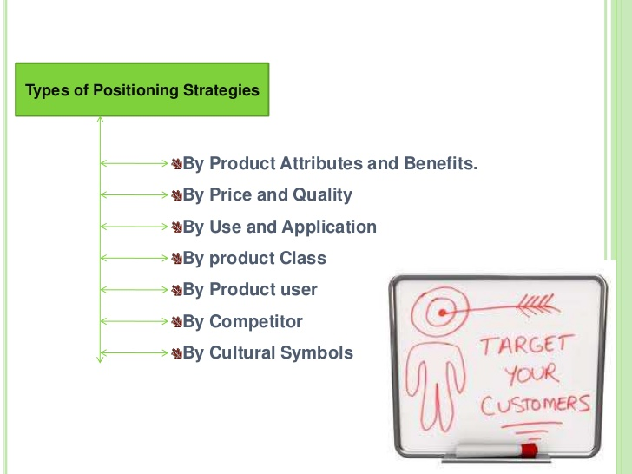
Positioning Strategies
Positioning strategies can be conceived and developed in a variety of ways.
It can be derived from the object attributes, competition, application, the types of consumers involved, or the characteristics of the product class.
All these attributes represent a different approach in developing positioning strategies

Slide 4
Building Digital Presence and Leveraging Social Media
Digital Presence means you occupy space online, 10 years ago digital presence meant having a web site, today we have social media, mobile, and all forms of online advertising to consider when it comes to creating digital presence and it encompasses so much more than just a web site.
The importance of digital presence. ... This is very important because of the major online media that enables a two-way relationship where the consumer can communicate with the company and wide open, exposing their problems as well as complaints and questions.

Slide 5
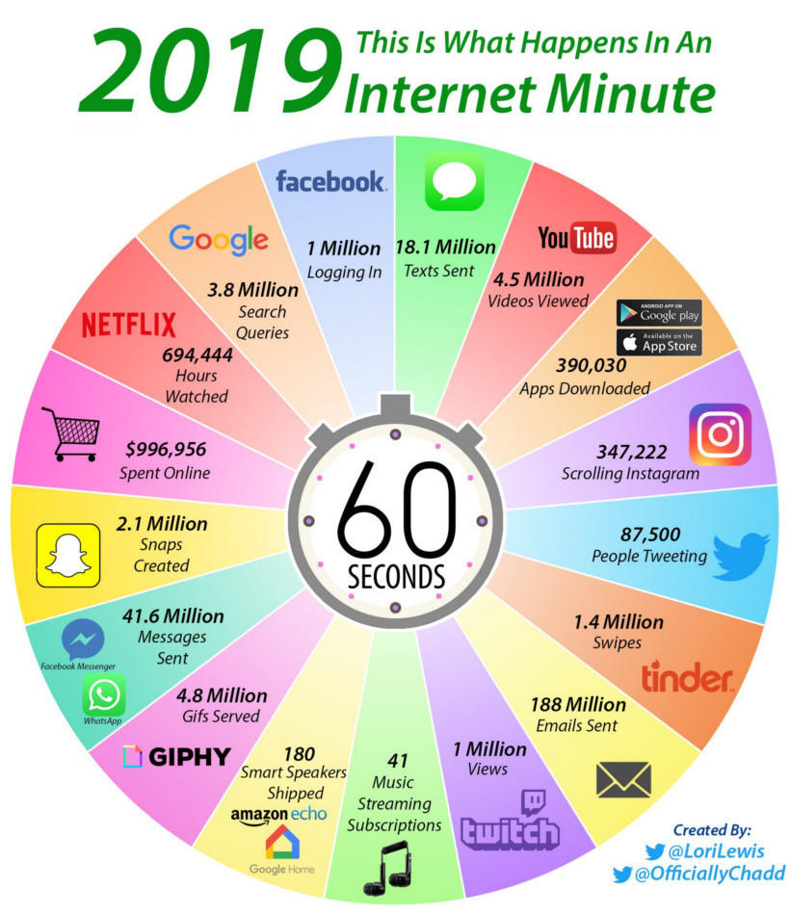
Measuring Effectiveness of Channels

Slide 6
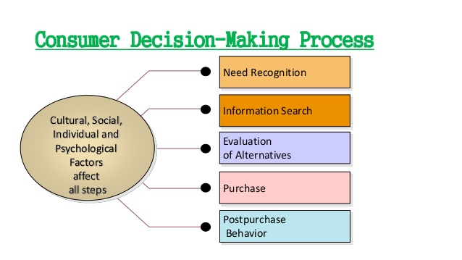
Customer Decision Making Process A consumer goes through several stages before purchasing a product or service.

Slide 7
Sales Plan and Targets
A sales plan is a strategy that sets out sales targets and tactics for your business, and identifies the steps you will take to meet your targets.
A sales plan will help you: define a set of sales targets for your business. ... activate, motivate and focus your sales team

Slide 8
An Effective Action Plan to Improve Sales Performance
Create a daily task list and stick to it.
Establish a plan for your team and hold them accountable.
Identify prime selling time.
Work on narrowing the revenue gap with cross-selling.
Call the right customers with the right offer.

Slide 9
UNIQUE SALES PROPOSITION
A Unique selling proposition (USP, also seen as unique selling point) is a factor that differentiates a product from its competitors, such as the lowest cost, the highest quality or the first-ever product of its kind.
A USP could be thought of as “what you have that competitors don't.”

Slide 10
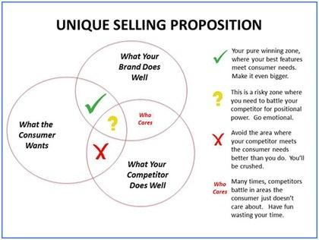

Slide 11
Follow Up and Close Sales
1. Ask for guidance on the best way to follow up with them while adding value and not being annoying.
2. Ask what their preferred form of communication is and if they will respond
3. Make sure you always end each conversation with a clearly defined next step.
4. Summarize your conversations and get written confirmation.
5. Always have a specific reason to contact your prospect. NEVER just call to ‘touch base’ or ‘check in’.

Slide 12
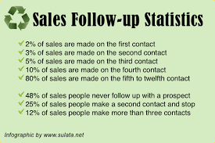

Slide 13
Business Regulation Of Starting and Operating a Business
The government has set any business regulations in place to protect employees' rights, protect the environment and hold corporations accountable for the amount of power they have in a very business-driven society.

Slide 14
Here’s a rundown of the business regulation categories to look out for:
1. Tax Code
For most small business owners, government regulation questions almost always begin with taxes. But there’s more to taxes than merely paying them—knowing which business taxes to pay, when to pay them, and how to set up your business to account for future tax payments can spare you a ton of headaches when it comes time to write the government a check.

Slide 15
2. Employment and Labor Law
There are also many government regulations on businesses that employ workers and independent contractors, in the form of federal and state labor laws.
Thankfully, if you’re just starting out, you can take advantage of the Department of Labor’s FirstStep Employment Law Advisor.
3. Antitrust Laws
Any time a company conspires with its competitors, third-party vendors, or other relevant parties, it may run afoul of antitrust laws.
You can easily familiarize yourself with the SBA’s handy list of issues that antitrust laws strive to address, such as the following:
Conspiring to fix market prices
Price discrimination
Monopolization:

Slide 16
4. Advertising
A good advertising strategy can do wonders for your business. But before you dive in, you’ll need to make sure that you’re playing by the rules and government regulations.
For example, you have to make sure the claims in your ads are not untruthful or purposely deceptive. Violating these rules can result in fines, which defeats the purpose of your advertising in the first place.
5. Environmental Regulations
You might need to acquaint yourself with various environmental protection laws, depending on your industry or business.
This is especially pertinent if you’re marketing, say, cleaning products, food, or anything with claims to be natural, organic, or eco-friendly.
You’ll find dozens of environmental rules and regulations that might affect your small business, both at the federal and state level.

Slide 17
6. Privacy
Businesses with staff and employees wind up amassing a ton of sensitive personal information about their employees.
As a result, there are a variety of rules and regulations about how employers must save and secure this data.
7. State Licensing
We’ve focused on federal laws and government regulations on business so far, but that doesn’t meant that there aren’t ample state regulations to consider for your small business.
Many state and local governments have their own requirements for businesses, and they’re just as important to understand as their federal counterparts.

Slide 18
START-UP ECOSYSTEM
Startup ecosystem is comprised of many players who create it. First and foremost are the startups themselves.
However, in order for startups to be successful, they need help from the other players, mainly Investors, but also service providers, accelerators, co working spaces (who promote events that bring the ecosystem together), startup organizations and tech reporters.

Slide 19
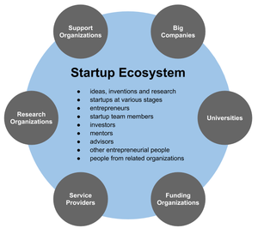

Slide 20
Government Schemes
Make In India
Start-up India
Atal Innovation Mission (Aim)
Support To Training And Employment Programme For Women (Step)
Jan Dhan- Aadhaar- Mobile (JAM)
Stand-up India
Biotechnology Industry Research Assistance Council (BIRAC)
Trade Related Entrepreneurship Assistance And Development (TREAD)
Pradhan Mantri Kaushal Vikas Yojana (PMKVY)
National Skill Development Mission

Slide 21
Government Schemes
The Government of India has undertaken several initiatives and instituted policy measures to foster a culture of innovation and entrepreneurship in the country.
With a significant and unique demographic advantage, India, however, has immense potential to innovate, raise entrepreneurs and create jobs for the benefit of the nation and the world.
MAKE IN INDIA: The make in India initiative was launched in September 2014.
It came as a powerful call to India's citizens and business leaders, and an invitation to potential partners and investors around the world to overhaul out-dated processes and policies, and centralize information about opportunities in India's manufacturing sector.
This has in turn helped procure investments, foster innovation, develop skills, protect intellectual

Slide 22
2. START-UP INDIA: Through the Startup India initiative, Government of India promotes entrepreneurship by mentoring, nurturing and facilitating startups throughout their life cycle.
With a 360 degree approach to enable startups, the initiative provides a comprehensive four-week free online learning program. More importantly, a ‘Fund of Funds’ has been created.
3. ATAL INNOVATION MISSION (AIM): AIM is the Government of India’s Endeavour to promote a culture of innovation and entrepreneurship, in technology driven areas.
In order to foster curiosity, creativity and imagination right at the school, Atal Incubation Centers (AICs) are another programme of AIM created to build innovative start-up businesses as scalable and sustainable enterprises.

Slide 23
4. SUPPORT TO TRAINING AND EMPLOYMENT PROGRAMME FOR WOMEN (STEP): STEP was launched by the Government of India’s Ministry of Women and Child Development to train women with no access to formal skill training facilities, especially in rural India.
The Ministry of Skill Development & Entrepreneurship and NITI Aayog recently redrafted the Guidelines to reaches out to all Indian women above 16 years of age.
To impart skills in several sectors such as agriculture, horticulture, food processing, handlooms, traditional crafts like embroidery, travel and tourism, hospitality, computer and IT services

Slide 24
5. JAN DHAN- AADHAAR- MOBILE (JAM): JAM, for the first time, is a technological intervention that enables direct transfer of subsidies to intended beneficiaries and, therefore, eliminates all intermediaries and leakages in the system, which has a potential impact on the lives of millions of Indian citizens.
Besides serving as a vital check on corruption, JAM provides for accounts to all underserved regions, in order to make banking services
6. STAND-UP INDIA: Launched in 2015, Stand-Up India seeks to leverage institutional credit for the benefit of India’s underprivileged.
It aims to enable economic participation of, and share the benefits of India’s growth, among women entrepreneurs, Scheduled Castes and Scheduled Tribes.

Slide 25
7. BIOTECHNOLOGY INDUSTRY RESEARCH ASSISTANCE COUNCIL (BIRAC): BIRAC is a not-for-profit Public-Sector Enterprise, set up by Department of Biotechnology to strengthen and empower emerging biotechnology enterprises.
It aims to embed strategic research and innovation in all biotech enterprises, and bridge the existing gaps between industry and academia.
BIRAC has initiated partnerships with several national and global partners for building capacities of the Indian biotech industry, particularly start-ups and SME’s.

Slide 26
8. TRADE RELATED ENTREPRENEURSHIP ASSISTANCE AND DEVELOPMENT (TREAD):
To address the critical issues of access to credit among India’s underprivileged women, the TREAD programme enables credit availability to interested women through non-governmental organizations (NGOs).
As such, women can receive support of registered NGOs in both accessing loan facilities, and receiving counseling and training opportunities to kick-start proposed enterprises, in order to provide pathways for women to take up non-farm activities

Slide 27
9. PRADHAN MANTRI KAUSHAL VIKAS YOJANA (PMKVY):
A flagship initiative of the Ministry of Skill Development & Entrepreneurship (MSDE), this is a Skill Certification initiative that aims to train youth in industry-relevant skills to enhance opportunities for livelihood creation and employability (Training and Assessment fees are entirely borne by the Government under this program).
10. NATIONAL SKILL DEVELOPMENT MISSION:
The seven sub-missions proposed across India are: (i) Institutional Training (ii) Infrastructure (iii) Convergence (iv) Trainers (v) Overseas Employment (vi) Sustainable Livelihoods (vii) Leveraging Public Infrastructure

